Slide 1
Inflation
Notes:
Not all price increases constitute inflation.
In a market economy like the U.S. economy, prices of individual goods continually change as supply and demand shift. Indeed, a major concern of microeconomics is understanding the way in which relative prices change—why, for example, have computers become less expensive over time and dental services more expensive?
In macroeconomics, we are concerned not with relative price changes, but with changes in the overall price level of goods and services.

Slide 2
Inflation
What is INFLATION?
What rate of inflation is desirable for growth?
Types of Inflation
Measurement of Inflation
Effects and Causes of Inflation
Consequences and Corrective Actions

Slide 3
What is INFLATION
“Inflation is a situation of “too much money chasing too few goods.” Coulborn
“Inflation is a state in which the value of money is falling, that is, prices are rising.” Crowther
Criticisms:
Every increase in price level is inflationary and has harmful consequences.
These definitions are alleged to be of little use in the formulation of anti-inflation policies.

Slide 4
What is INFLATION
“Inflation is a persistent and appreciable rise in the general level or average of prices.” Ackley
The term ‘persistent’ implies that the price level continues to rise and does not respond to anti-inflationary policies.
The term ‘appreciable’ is more ambiguous because it does not specify as to what rate of increase in the price level is to be considered as ‘appreciable’ or ‘considerable’—5%, 10%, 30% per month or per annum or what?
Sustained inflation occurs when the overall price level continues to rise over some fairly long period of time.
Problem
Prices rise faster than income
Standard of living declines

Slide 5
Caution!
Any rise in the general price level is not inflation
Inflation is rise in the general price level over and above the base year level. This is the concept of inflation which is generally used in the analysis of price behavior.
Notes:
According to these definitions, one thing we can state that any rise in general price level is not inflation. Only the persistent, prolonged and sustained and appreciable rise in the general price level can be defined as inflation.

Slide 6
What rate of inflation is desirable?
Moderate rate of inflation is considered to be desirable and acceptable.
It keeps the economic outlook optimistic, promotes economic activity and prevents economic stagnation.
It is helpful in the mobilization of resources by increasing the overall rate of savings and investment—inflationary financing has, in fact, been widely used to finance economic growth of the underdeveloped countries.
Increase in the general price level is inevitable in a dynamic and progressive economy.

Slide 7
As per the past experience, a price rise of 2-3 percent per annum in the developed and 4-5 percent per annum in the developing economies is generally considered as the desirable rate of inflation.
In India, the Chakravarty Committee (1985), a Committee set up by the RBI to review the monetary system of the country, considered a 4% rate of inflation as socially desirable and conducive to economic growth.
Notes:
So as long as the general level of price rises at the rate of 2-3% in developed economies and 4-5% in developing economies, and macroeconomic variables are not adversely affected by the price rise, an anti-inflationary policy steps are not advisable as it may distort the price system and affect adversely the employment and growth process.

Slide 8
Price rise on account of the following factors cannot be taken to be inflationary:
(i) price rise due to change in the composition of GDP in which high-price industrial goods replace the low-price farm products;
(ii) price rise due to qualitative change in the products across the board;
(iii) price rise due to change in price indexing system, and
(iv) recovery in price after recession.

Slide 9
Inflation, Disinflation and Deflation
Inflation refers to a persistent increase in the general price level.
Disinflation means decline in the rate of prices
Deflation means fall in the general price level below the base-year level.

Slide 10
Example:
Annual rate of inflation was 4.4% in 2005-06.
In India, the weekly rate of inflation had shot up to 13.1% in the August 2008 and the annual inflation rate had gone up to 12.81% in 2008. Thereafter, inflation rate started declining setting a disinflationary trend.
In the September 2008 inflation rate declined to 12.14%. Inflation rate had sharply declined to 6.61% in the December 2008 due mainly to the recession in the economy caused by the impact of global recession. This decline in the inflation rate was, in fact, disinflation.
The disinflationary trend continued and inflation rate declined to 0.13% in the May 2009, i.e., inflation rate had fallen to a near-zero level.
The price level continued to decline and fell to – 1.61% in the June 2009 and –1.31% in the last week of June. This marked a situation of deflation in India.

Slide 11
Types of inflation
On the basis of rate/speed of inflation
1. Creeping inflation: mildest form of inflation – makes the economy dynamic.
Prices rise slowly
Industry and trade receive stimulus and the country develops economically.
According to some economists, price level should rise by approx. 2% annually under creeping inflation.

Slide 12
Types of inflation
2. Walking inflation:
When price rise become intense and quantum of inflation gains momentum.
Rate of increase of price-level gets further accelerated – rises by approx 5% annually.
If proper control is not exercised, it can easily assume the form of running inflation.
3. Running:
price-level rises by approx 10% annually.

Slide 13
4. Galloping or Hyper inflation:
“Galloping inflation refers to an inflation that proceeds at an exceptionally high rate.” Baumol and Blinder
Prices rise every minute and there is no upward limit to which it may rise in course of time.
Lord Keynes has called it true inflation.
This type invariably occurs after the point of full employment.
Double or triple digit rise in price level.
The post-War I inflation in Germany during 1922 is often cited as a classic example of galloping inflation though some would call it hyper inflation.
The annual average rate of inflation in Argentina—416.9 percent; Brazil—327.6 percent; Peru—287.3 percent; former Yugoslavia—123.0 percent; and Mexico—66.5 percent during 1980-91 was exceptionally high. Incidentally, these cases are also cited as the examples of hyper inflation.
Notes:
Inflation shot up to 100 million % between Dec 1922 and 1923. The price rise in zillion and quadrillion percent makes the meaning of hyper inflation. During this period paper currency becomes worthless and demand for money decreases drastically.

Slide 14
Types of inflation
On the basis of degree of government control
Open inflation: A situation in which no steps are taken by government to control rising prices.
Suppressed inflation: A situation in which rising prices are checked by administrative measures like rationing, price control, etc.
Notes:
The control and regulation of prices by direct and indirect measures include monetary and fiscal control measures, price control in the form of fixation of price ceiling, rationing the goods, public distribution system, subsidization of commodities, etc. Inspite of control measures, prices do rise and inflation does take place but at lower rate.

Slide 15
Types of inflation
On the basis of scope
Sectoral inflation
Comprehensive inflation
On the basis of process of rise in prices
Wage induced
Profit induced/Mark-up inflation
Deficit induced
Demand pull inflation
Cost push inflation

Slide 16
Demand-Pull Inflation
Inflation is caused by an excess of demand (spending) relative to the available supply of goods and services at existing prices.
The Classical - the key factor is the money supply. The quantity theory of money => only an increase in money supply is capable of raising the general price level.
In Modern income theory, means an excess of aggregate demand relative to the economy’s full employment output level. Prices rise in response to an excess of aggregate demand over existing supply of goods and service => caused by an increase in quantity of money
May also be caused when MPC goes up causing an increase in expenditures and hence prices.

Slide 17
Demand Pull Inflation
S
D₂
D₁
P₂
D₀
Price level
P₁
P₀
S
Q₀
Quantities Demanded and Supplied

Slide 18
Cost Push Inflation
This theory maintains that prices, instead of being pulled-up by excess demand, are pushed-up as a result of a rise in the cost of production.
Prices rise on account of a rise in the cost of raw materials, wages etc.
Some producers, group of workers, or both, succeed in raising the prices for either their products or services above the levels that would prevail under more competitive conditions.
Inflation of the cost-push type originates in industries, which are relatively concentrated, and in which, sellers can exercise considerable discretion in the formulation of both prices and wages.

Slide 19
S
D₂
D₁
D₀
P₁
Price level
P₀
S2
S₁
S₀
Q₂
Q₁
Q₀
Quantities Demanded and Supplied

Slide 20


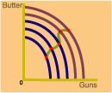

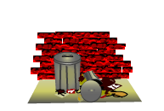



Shifts of the Short-Run Aggregate Supply Curve
Factors That Shift the Aggregate Supply Curve
Shifts to the Right Increases in Aggregate Supply
Shifts to the Left Decreases in Aggregate Supply
Lower costs lower input prices lower wage rates
Higher costs higher input prices higher wage rates
Economic growth more capital more labor technological change
Stagnation capital deterioration
Public policy supply-side policies
tax cuts
deregulation
Public policy waste and inefficiency over-regulation
Good weather
Bad weather, natural disasters, destruction from wars

Slide 21
Measurement of Inflation
1. Percentage change in Price Index Numbers (PIN)
Wholesale Price Index (WPI), also called Producer Price Index (PPI): WPI is used to measure the general rate of inflation
Consumer Price Index (CPI): CPI is used to measure the change in the cost of living index.
2. Change in GDP Deflator
Notes:
While WPI is used at the macro level policy making, the CPI is used for micro level analyses. The inflation at the WPI is the inflation of the economy. A Working Group for Revision of WPI Number was set up under the chairmanship of Prof. Abhijit Sen to announce the new series of WPI. The revised series of WPI as announced on September 2010 and represents a basket comprising 676 commodities with base 2004-05 against 435 in the old series with base 1993-94. Of 676 commodities, 102 are primary articles (20%), 19 are fuel and power(15%), and 555 are manufacturing products (65%).

Slide 22
Measuring Inflation
The Consumer Price Index (CPI) is a measure of the average change over time in the prices paid for a constant market basket of consumer goods and services. The percent change in the CPI is a measure for estimating inflation.
How is the CPI market basket determined?
The CPI market basket is developed from detailed expenditure information provided by families and individuals on what they actually bought.
The data is collected through household expenditure survey.
Notes:
Depending upon the socio economic differentiation among consumers, India has four differing sets of CPI with some differentials in the basket of commodities.
CPI for industrial workers- 260 items
CPI for urban non manual employees- 146-365 items
CPI for agricultural labourers- 260 commodities
CPI for rural labourers-260 items
NEW CPI for Rural, Urban and combined on base 2010 was introduced for the month January 2011 by CSO.
Five major groups were considered in new series of CPI
Food, beverages and tobacco
Fuel and lighting
Housing
Clothing, bedding, and footwear
Miscellaneous

Slide 23
What goods and services does the CPI cover?
The CPI represents all goods and services purchased for consumption by the reference population on major groups i.e., on:
Food and Beverages
Housing
Apparel
Transportation
Medical Care
Recreation
Education and Communication
Other Goods and Services
The CPI does not include investment items, such as stocks, bonds, real estate, and life insurance. (These items relate to savings and not to day-to-day consumption expenses.)

Slide 24
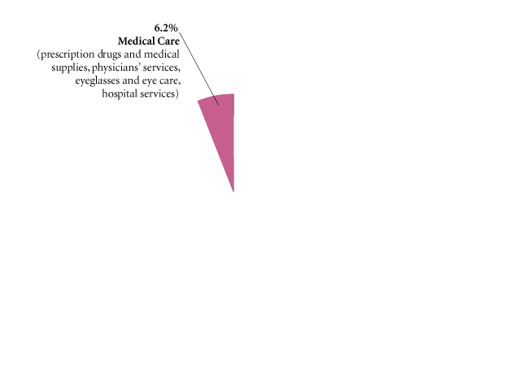
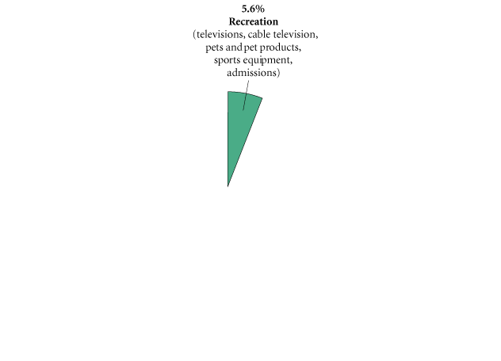
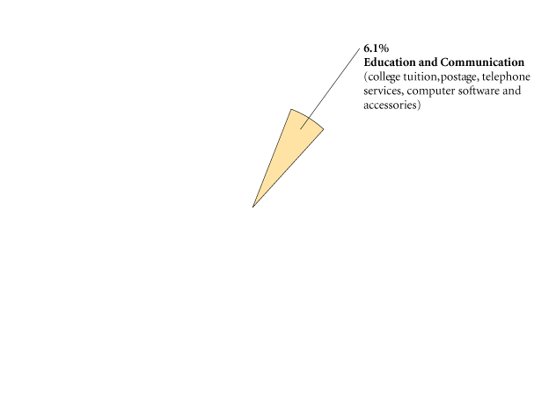
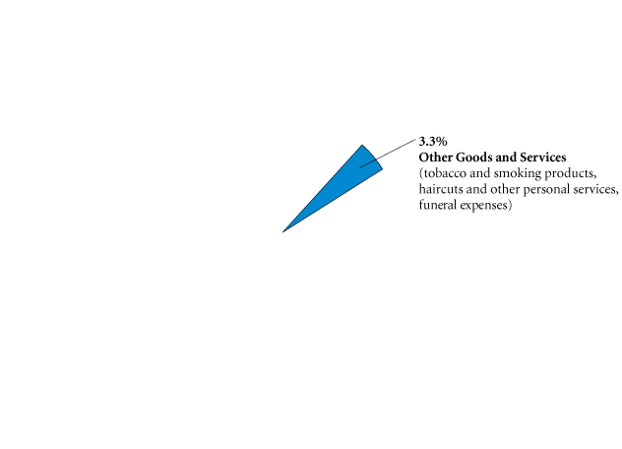
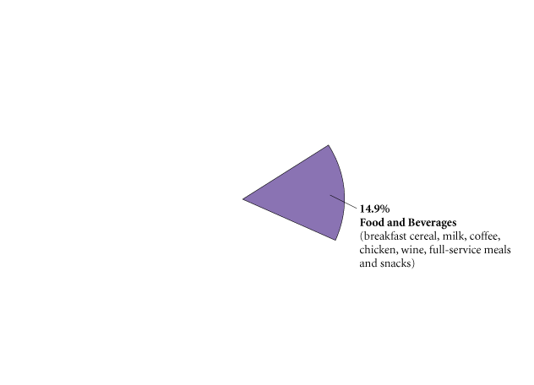
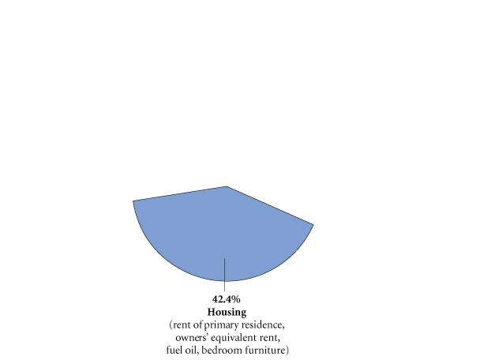
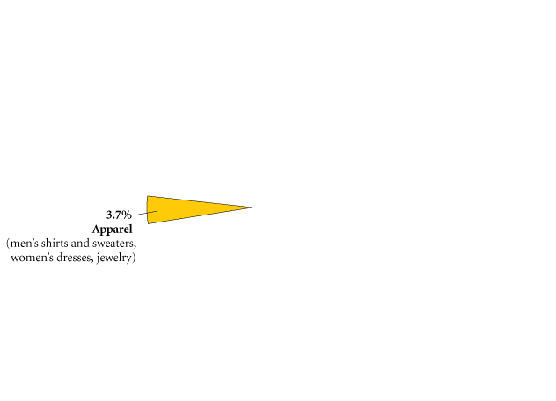
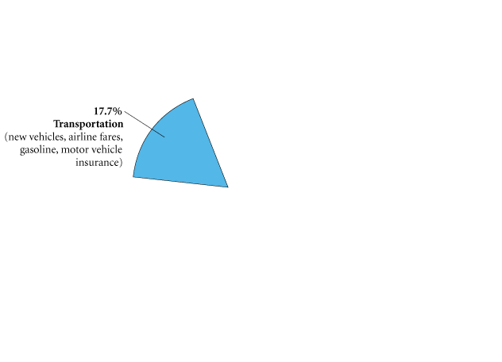
The Consumer Price Index for US
FIGURE The CPI Market Basket
The CPI market basket shows how a typical consumer divides his or her money among various goods and services. Most of a consumer’s money goes toward housing, transportation, and food and beverages.
Source: The Bureau of Labor Statistics

Slide 25
TABLE 22.5 The CPI, 1950–2007
 | Percentage Change in CPI | CPI |  | Percentage Change in CPI | CPI |  | Percentage Change in CPI | CPI
1950 | 1.3 | 24.1 | 1969 | 5.5 | 36.7 | 1988 | 4.1 | 118.3
1951 | 7.9 | 26.0 | 1970 | 5.7 | 38.8 | 1989 | 4.8 | 124.0
1952 | 1.9 | 26.5 | 1971 | 4.4 | 40.5 | 1990 | 5.4 | 130.7
1953 | 0.8 | 26.7 | 1972 | 3.2 | 41.8 | 1991 | 4.2 | 136.2
1954 | 0.7 | 26.9 | 1973 | 6.2 | 44.4 | 1992 | 3.0 | 140.3
1955 | −0.4 | 26.8 | 1974 | 11.0 | 49.3 | 1993 | 3.0 | 144.5
1956 | 1.5 | 27.2 | 1975 | 9.1 | 53.8 | 1994 | 2.6 | 148.2
1957 | 3.3 | 28.1 | 1976 | 5.8 | 56.9 | 1995 | 2.8 | 152.4
1958 | 2.8 | 28.9 | 1977 | 6.5 | 60.6 | 1996 | 3.0 | 156.9
1959 | 0.7 | 29.1 | 1978 | 7.6 | 65.2 | 1997 | 2.3 | 160.5
1960 | 1.7 | 29.6 | 1979 | 11.3 | 72.6 | 1998 | 1.6 | 163.0
1961 | 1.0 | 29.9 | 1980 | 13.5 | 82.4 | 1999 | 2.2 | 166.6
1962 | 1.0 | 30.2 | 1981 | 10.3 | 90.9 | 2000 | 3.4 | 172.2
1963 | 1.3 | 30.6 | 1982 | 6.2 | 96.5 | 2001 | 2.8 | 177.1
1964 | 1.3 | 31.0 | 1983 | 3.2 | 99.6 | 2002 | 1.6 | 179.9
1965 | 1.6 | 31.5 | 1984 | 4.3 | 103.9 | 2003 | 2.3 | 184.0
1966 | 2.9 | 32.4 | 1985 | 3.6 | 107.6 | 2004 | 2.7 | 188.9
1967 | 3.1 | 33.4 | 1986 | 1.9 | 109.6 | 2005 | 3.4 | 195.3
1968 | 4.2 | 34.8 | 1987 | 3.6 | 113.6 | 2006 | 3.2 | 201.6
 |  |  |  |  |  | 2007 | 2.8 | 207.3
Sources: Bureau of Labor Statistics, U.S. Department of Labor.

Slide 26
General Price Level
Weighted average of individual goods’ prices.
n
P_{t} = S w_{i} P_{it}
i=1
w_{i} >= 0
S w_{i} = 1

Slide 27
Example
Suppose there are only 3 goods in the economy, with their prices in 2003 and weights as follows:
Goods | Price | Weight
Rice | Rs. 15 / kg | 0.6
Shirt | Rs. 200 / piece | 0.3
House (room) | Rs.1000 / month | 0.1

Slide 28
General price in 1999
P₂₀₀₃ = 0.6 (15) + 0.3 (200) + 0.1 (1000) = Rs. 169
Note: the general price is merely a concept. There is nothing particular that you can buy for Rs. 169.

Slide 29
Weights
The weights for the various component items are determined by the relative significance of that item in all the items during the base period.
Q_{i0} P_{i0}
W_{i} = ------------------
Σ Q_{i0} P_{i0}
i
where Q_{i0} and P_{i0} are the quantity and price of the good ‘i’ in the base period.

Slide 30
Price Index
A Price Index is expressed as the current price in relation to its value in the base period.
Thus, price index for period t is defined as:
PI_{t} = P_{t} / P₀
Example: Price of shirt in base year, say 1999 was Rs. 120 and in 2006 it was Rs.200, the price index
PI ₂₀₀₆ = Rs. 200 / Rs. 120 = 1.67

Slide 31
About Price index
An index helps to compare the data without worrying about the unit of measurement.
Price Index of 1.67 indicates that between 1999 and 2006, price of shirt has increased by 67 %.
Index numbers are usually written with a base value = 100 (above number has to be multiplied by 100).

Slide 32
Measuring the Inflation
It means the rate of change in general price (P or PI) per year, expressed in percentages.
Thus, the simple inflation rate in period t (Pt) over the last one year is given by:
P_{t} – P _{t-1}
Inflation rate_{t} = ------------- x 100
P_{t-1}
If it is compounded once in a year only.
If compounding is done on a continuous basis:
P_{t}
P_{t} = ln ------ x 100
P_{t-1}
where ln stands for natural logarithm.

Slide 33
Example
If the general price index rises from, say, 150 in 1998 to 160 in 1999,
the simple inflation rate during 1998-99 = 6.67% {(160-150)/150 x 100}
and the continuous compounded inflation rate = 6.45 % {ln (160/150) x 100}.
In practice, the annual compounding rate is often used.

Slide 34
Worked Out Example
Calculate Inflation rate for 2011 (taking 2010 as the base year) and 2012 (by taking 2011 as the base year.
Year | Price of Burgers($) | Quantity of Burgers | Price of Milkshakes($) | Quantity of Milkshakes
2010 | 2.00 | 100 | 1.00 | 50
2011 | 3.00 | 120 | 1.50 | 75
2012 | 4.00 | 125 | 3.00 | 25
Wt (Burger) 2010 =200/250 [2x100/(200+50] =0.8 Wt (Milkshake) 2010 = 50/250 [50x1/200+50] = 0.2
PI for 2010=(2x0.8+1x0.2)= 1.6+0.2= 1.8
PI for 2011=(3x0.8+1.5x.0.2)= 2.4+0.3= 2.7
Inflation Rate for 2011= 2.7-1.8/1.8 = 0.5 = 0.5x100=50%
Wt (Burger) 2011 =360/ 472.5 [3x120/(3x120+1.50x75] =360/(360+112.5)=0.76
Wt (Milkshake) 2011 = 112.5/472.5 [1.50x75/(3x120+1.50x75)] = 0.24
PI for 2011=(3x0.76+1.5x0.24)= 2.28+0.36=2.64
PI for 2012=(4x0.76+3x0.24)=3.04+0.72=3.76
Inflation Rate for 2012= 3.76-2.64/2.64= 0.42= 0.42x100= 42%

Slide 35
Worked Out Example
Period | Pizza |  | Jeans |  | Movie Ticket
 | Price | Qty | Price | Qty | Price | Qty
2009 | 25 | 400 | 1000 | 50 | 50 | 40
2010 | 30 | 500 | 1200 | 70 | 60 | 70
Wt (Pizza) = 10,000/62000 [25 x 400 / (10,000+50,000+2,000)] Wt (Jeans) = 50,000/62,000 [1000 x 50 / (10,000+50,000+2,000)] Wt (Movie Ticket) = 2,000/62,000 [50 x 40 / (10,000+50,000+2,000)]
PI for 2009=(25x10/62) + (1000x50/62) + (50x2/62) = 250/62 + 50,000/62 + 100/62 = 50,350/62 = 812.097
PI for 2010=(30x10/62) + (1200x50x/62) + (60x2/62) = 300/62 + 60,000/62 + 120/62 = 60,420/62 = 974.52
Inflation Rate = 974.52-812.097 / 812.097 = 0.20 x 100 = 20%

Slide 36
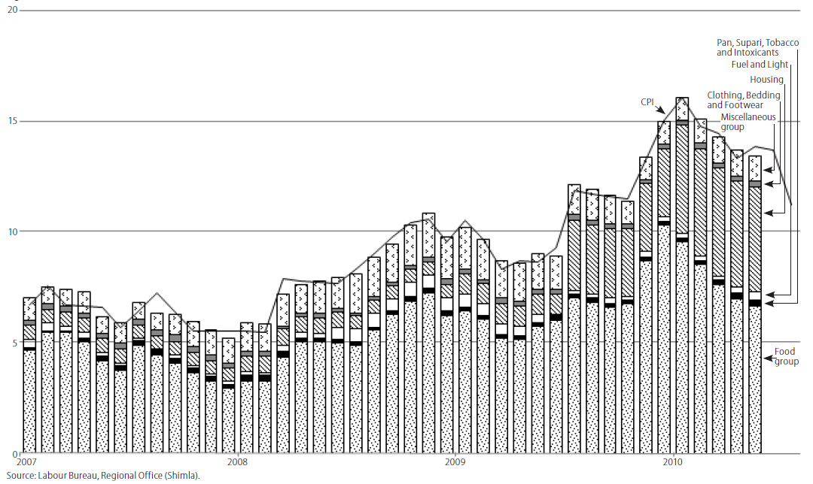
Factors contributing to Consumer Prices

Slide 37
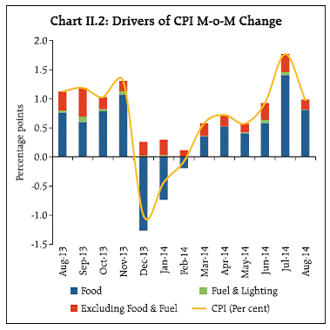
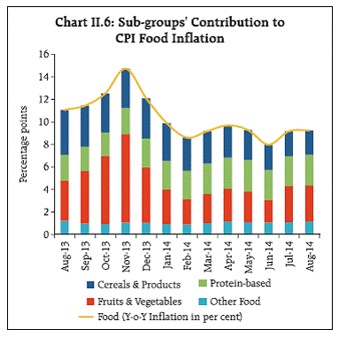
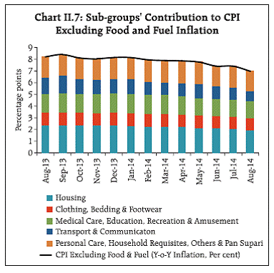
Drivers of Inflation
Food price shocks have large and persistent effects on inflation expectations
Within food group, cereals and fruits and vegetables are major contributor
Inflation due to non-food items remained stable since September 2013 in response of monetary policy actions.

Slide 38
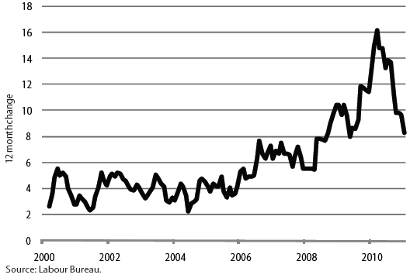
Consumer Price Inflation in India (in %)

Slide 39
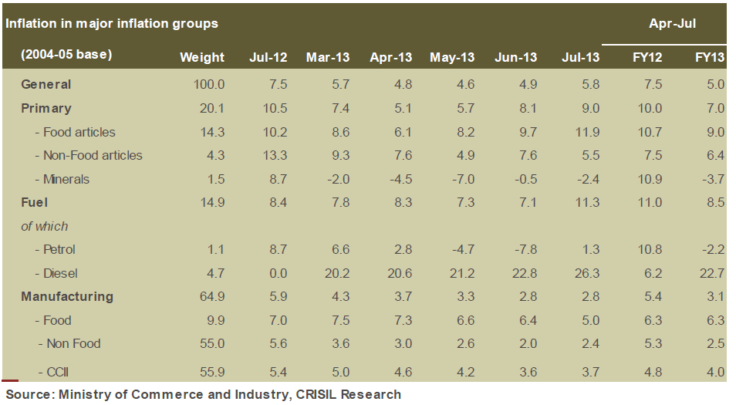

Slide 40
Effects of Inflation

Slide 41
Effects on Production
Mild inflation is beneficial to the economy.
Hyperinflation disrupts the economy: discourages savings => capital accumulation falls. Drives out foreign capital already invested in the economy.
Volume of production will fall not only on account of fall in capital accumulation, but also due to the uncertainty.
Pattern of production may change.
Seller’s market => result in deterioration of the quality of goods produced.
Most serious: disrupts the smooth functioning of the price mechanism.

Slide 42
Consequences of high inflation
• Inertial inflation: prices and wages adjust to past inflation through contractual adjustment.
Hyperinflation: wages and prices anticipate future inflation (and v rises). In both an underlying conflict over income distribution.
• Supply shortages (e.g. droughts, wars) can cause inflation. Serious redistributive consequences for the poor. Price controls lead to shortages of essential goods (rationing and black markets).
• Inflation also causes uncertainty, leading to hoarding by households and no investment by firms; eventually can lose to market collapse as money loses its functions.
Notes:
Wage spiral prevails here: Price rises, workers demand more wages, wages increase to compensate workers. As wages increase, input cost increase, cost of production increase, prices rise.
On the other hand, increase in wages lead to increased demand, supply remaining same lead to rise in price.
Therefore, wage and price spiral inflicts the economy.

Slide 43
Effects on Distribution
Results in redistribution of income and wealth.
Debtors & Creditors: Debtors are gainers – they borrowed when purchasing power of money was high and return the loans when pp of money is low due to rising prices. Creditors are losers – receive less in real terms
Wage & Salary Earners: wages do not rise proportionally with rise in cost of living. If they are well organized in trade unions, they may not suffer much.
Farmers: gain – prices of farm products go up while costs incurred do not go up to the same extent – time lag between rise in prices and costs. Farmers are generally debtors and can repay their debts in terms of less purchasing power.

Slide 44
Fixed income groups: hardest hit – persons who live on past savings, pensioners, interest and rent receivers suffer most during inflation.
Entrepreneurs: Inflation is a boon – whether manufacturers, traders, merchants and businessmen – rising prices serve as a tonic for business enterprise – experience windfall gains as the prices of their inventories (stocks) suddenly go up. Also gain as their costs (on wages, raw materials, etc) do not go up as rapidly as prices.
Investors: of two types
(a) Invest in equities (shares) – Dividends on equities increase with increase in prices and corporate earnings.
(b) Invest in fixed interest- yielding bonds and debentures – income from bonds remain fixed and as such they have much to lose during inflation. Frequently, the value of their savings is largely, if not completely, wiped out as a result of depreciation in the value of money.

Slide 45
Measures to Control Inflation
Notes:
Inflation can be compared to robbery. Both deprive their victim of some possession with the difference that the robber is visible, inflation is invisible; the robber’s victim may be one or few at a time, the victim of inflation are whole nation.

Slide 46
Halting inflation
• In the short run, the only ‘cure’ for inflation is to reduce expenditure – but whose? Wage contracts can be de-indexed, policy interest rates raised and public expenditure cut. But with severe political costs.
• In the medium term, the only solution is increased supply. Simulated in the short run by large-scale imports (aid, debt) to reduce inertial inflation. But demand cuts in the short run reduce investment required to increase supply in the long run.
• The current fashion for independent central banks (so politicians cannot monetize fiscal deficits) is an institutional approach to permanently altering market expectations.

Slide 47
Monetary Policy
Measures adopted by the Central Bank such as
Increase in reserve ratios: cash reserve ratio and statutory liquidity ratio; and
Sale of government securities in the open market: mops up excessive purchasing power from the public
Increase in re-discount rates: increases the cost of borrowing for business and consumer spending and discourages excessive activity based on borrowed funds
Adjustments in selective controls: consumer credit control and higher margin requirements, etc.

Slide 48
Repo (Repurchase) Rate
Repo rate is the rate at which banks borrow funds from the RBI to meet the gap between the demand they are facing for money (loans) and how much they have on hand to lend.
If the RBI wants to make it more expensive for the banks to borrow money, it increases the repo rate; similarly, if it wants to make it cheaper for banks to borrow money, it reduces the repo rate.
Reverse Repo Rate
The rate at which RBI borrows money from the banks (or banks lend money to the RBI) is termed the reverse repo rate. The RBI uses this tool when it feels there is too much money floating in the banking system
If the reverse repo rate is increased, it means the RBI will borrow money from the bank and offer them a lucrative rate of interest. As a result, banks would prefer to keep their money with the RBI (which is absolutely risk free) instead of lending it out (this option comes with a certain amount of risk)
Consequently, banks would have lesser funds to lend to their customers. This helps stem the flow of excess money into the economy

Slide 51
Fiscal Policy
Government Expenditure: during inflation, effective demand increases far too much due to unregulated private spending. To counteract this, the government should reduce its own expenditure to the minimum.
Taxation: the problem is to reduce the size of the disposable income in the hands of the general public. The rates of existing taxes should be increased while new taxes should be imposed.
Public Borrowing: the objective is to take away from the public excess purchasing power. Public borrowing may be voluntary or compulsory.

Slide 52
Policy of Physical Controls
Expansion of output: increased production is the best antidote to inflation – steps should be taken to increase output of those goods, which seem to be extremely sensitive to inflationary pressures by shifting resources.
Wage Policy: wage increase has to be controlled – wages should be allowed to rise only if there is an increase in the productivity, i.e. output per worker. In such a situation, higher wages will not give rise to higher costs and hence to higher prices.
Price Control and Rationing: the objective of price control is to lay down the upper limit beyond which, the price of a particular commodity will not be allowed to rise. Demand can also be controlled through rationing of essential commodities.

